Slide 1
Ontology in Computer Science

Slide 2
Taxonomy
The practice and science of classification of things or concepts in a hierarchical structure, organized by generalization‐specialization relationships

Slide 3
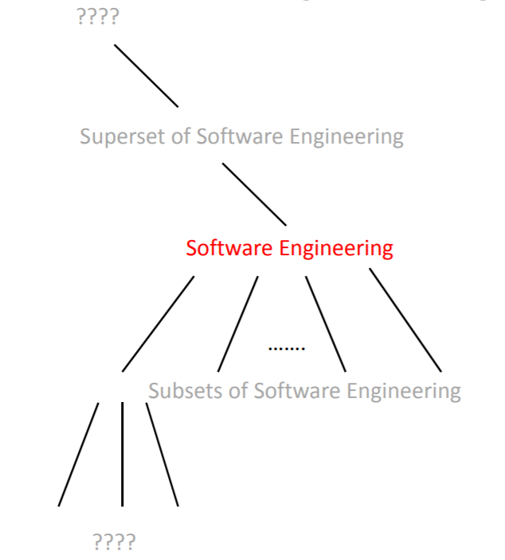
IEEE Taxonomy – Software Engineering

Slide 4
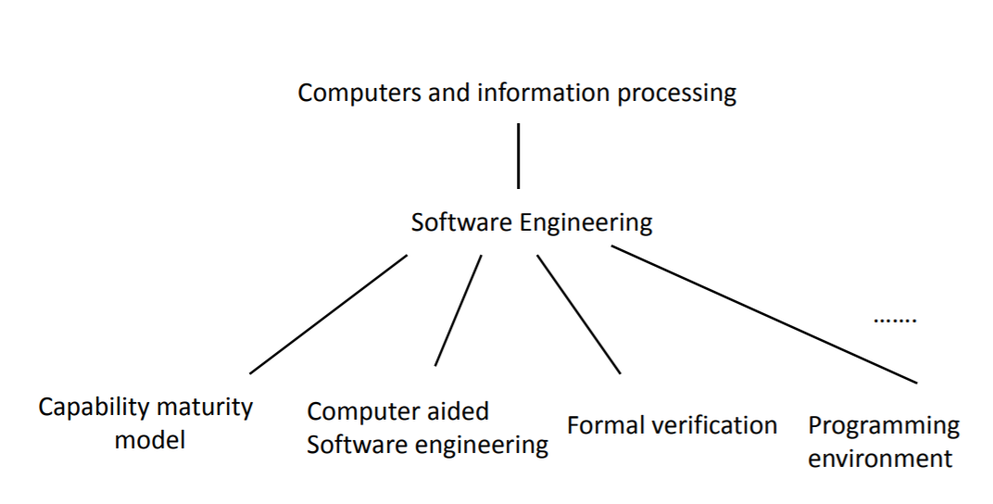
IEEE Taxonomy – Software Engineering

Slide 5
IEEE Taxonomy – Software Engineering
Alternative taxonomy for Software Engineering ???

Slide 6
Taxonomies
Biological taxonomies
Disease taxonomies
Economic taxonomies
Military taxonomies
Safety taxonomies

Slide 7
Thesaurus
“A controlled vocabulary arranged in a known order and structured so that hierarchical, equivalence, and associative relationships among terms are displayed clearly and identified employed reciprocally.”
This means that a thesaurus uses associative relationships in addition to parent-child relationships.

Slide 8
Thesaurus (cont’d)
“The primary purposes of a thesaurus are:
To facilitate retrieval of documents and
To achieve consistency in the indexing of written or otherwise recorded documents and other items, mainly for postcoordinate information storage and retrieval systems”

Slide 9
The Definition of Ontology(i)
“An ontology defines the basic terms and relations comprising the vocabulary of a topic area, as well as the rules for combining terms and relations to define extensions to the vocabulary”

Slide 10
The Definition of Ontology (ii)
“An ontology is an explicit specification of a conceptualization”

Slide 11
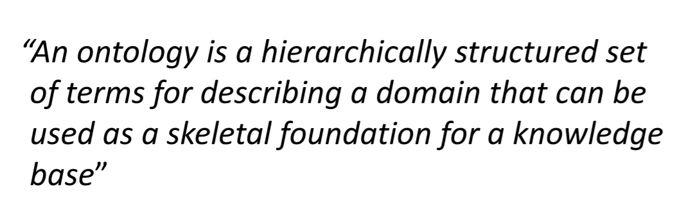
The Definition of Ontology (iii)

Slide 12
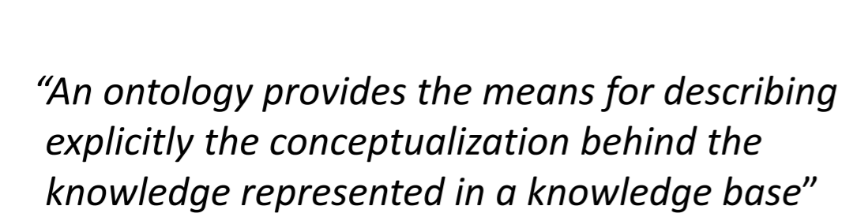
The Definition of Ontology (iv)

Slide 13
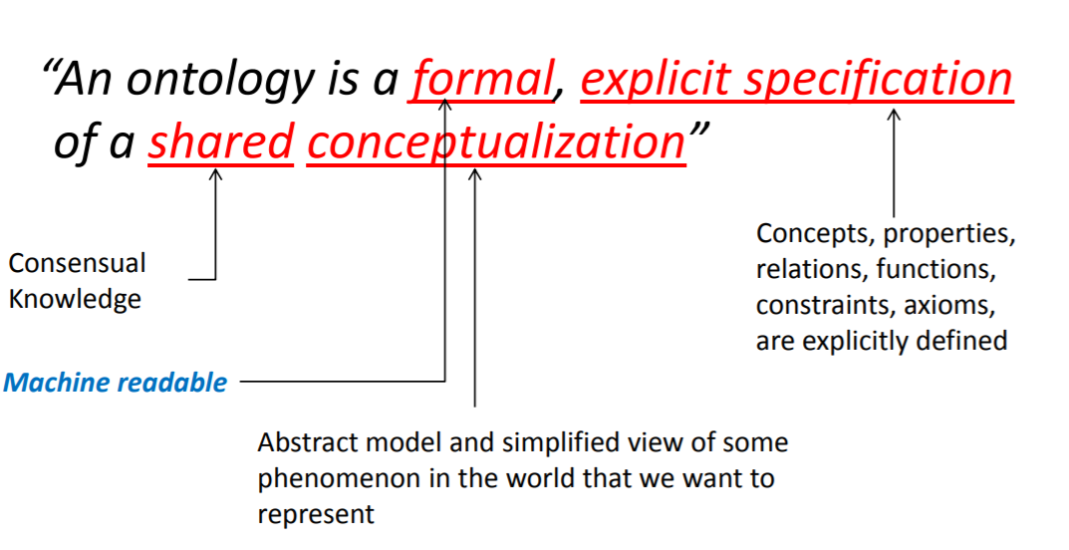
The Definition of Ontology (v)

Slide 14
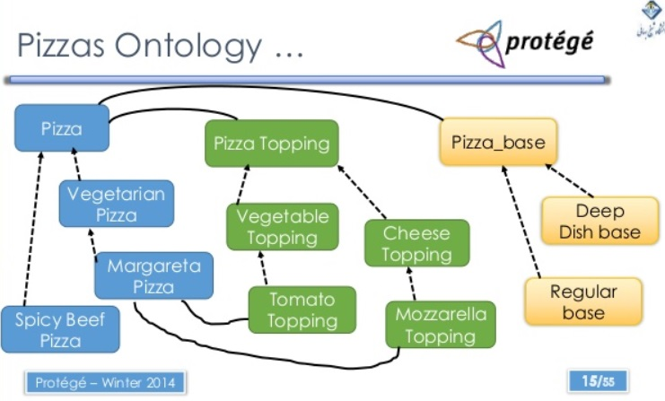

Slide 15
W3C consortium
“Ontology is a term borrowed from philosophy that refers to the science of describing the kinds of entities in the world and how they are related”

Slide 16
W3C consortium
W3C organization also suggests that ontologies should provide descriptions for the following elements:
• Classes (or “Things”) in the various domains of interest
• Relationships among those “Things”
• Properties (or attributes) that “Things” should possess

Slide 17
Differences Among Taxonomies, Thesauri, and Ontologies
Taxonomies Versus Ontologies:
Definition of Taxonomy:
The classification of information entities in the form of a hierarchy, according to the presumed relationships of the real-world entities that they represent

Slide 18
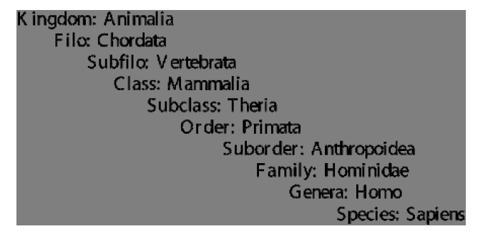
Linnaean taxonomy of the living beings — human classification(Taxonomies Versus Ontologies)

Slide 19
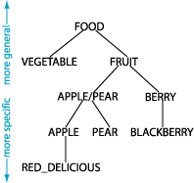

Slide 20
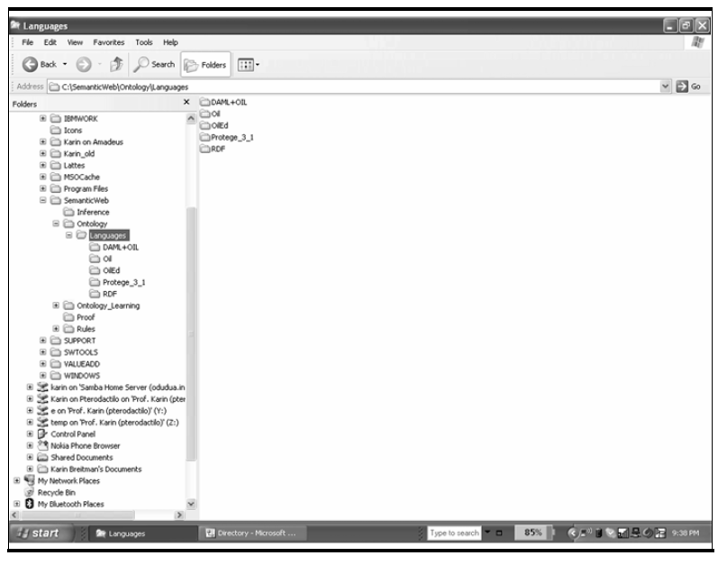
Directory structure example (Taxonomies Versus Ontologies) .

Slide 21
Thesauri Versus Ontologies
A thesaurus contains a set of relationships among concepts, organized in a taxonomic way.
The taxonomy underlying a thesaurus may have either weak or strong semantics.

Slide 22
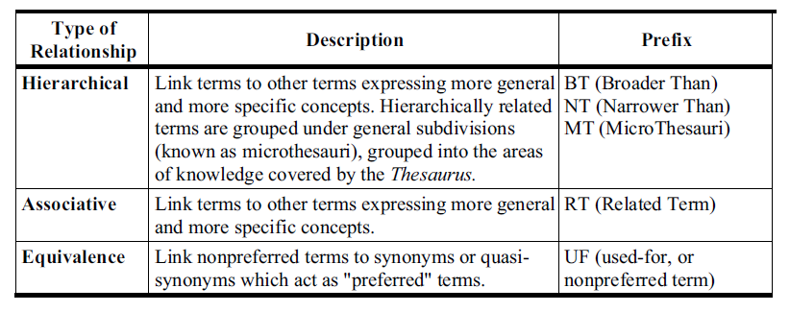
Relationships in the UNESCO Thesauri (Thesauri Versus Ontologies)

Slide 23
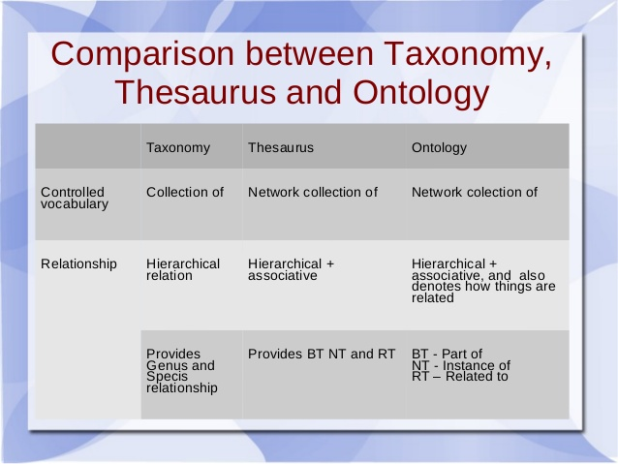

Slide 24
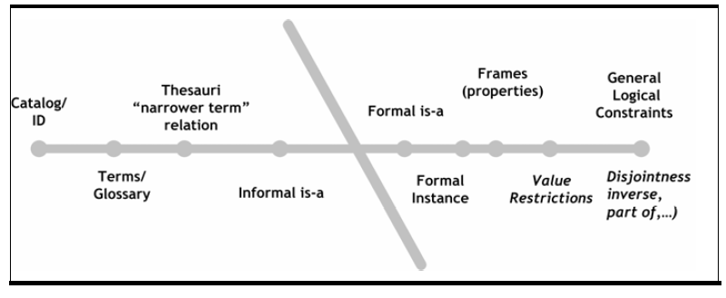
Classifying Ontologies

Slide 25
Classifying Ontologies According to a Semantic Spectrum
Controlled vocabularies are finite lists of terms.
Thesauri are lists of terms and definitions that standardize words for indexing purposes.
Informal is-a hierarchies are hierarchies that use generalization (type-of) relationships in an informal way.
Classifying Ontologies

Slide 26
Formal is-a hierarchies are hierarchies that fully respect the generalization relationship.
Frames are models that include classes and properties after the frame representation.
Ontologies that express value restrictions are ontologies that provide constructs to restrict the values their class properties can assume.
Ontologies that express logical restrictions are ontologies that allow first-order logic restrictions to be expressed.
Classifying Ontologies

Slide 27
Classifying Ontologies According to Their Generality
Upper Level Ontologies describe generic concepts, such as space, time, and events.
Domain Ontologies describe the vocabulary pertaining to a given domain, by specializing the concepts provided by the upper-level ontology.
Task Ontologies describe the vocabulary required to perform generic tasks or activities, again by specializing the concepts provided by the upper-level ontology.
Classifying Ontologies

Slide 28
Application Ontologies describe the vocabulary of a specific application, whose concepts correspond, in general, to the roles performed by entities in a given domain while performing some task or activity.
Classifying Ontologies

Slide 29
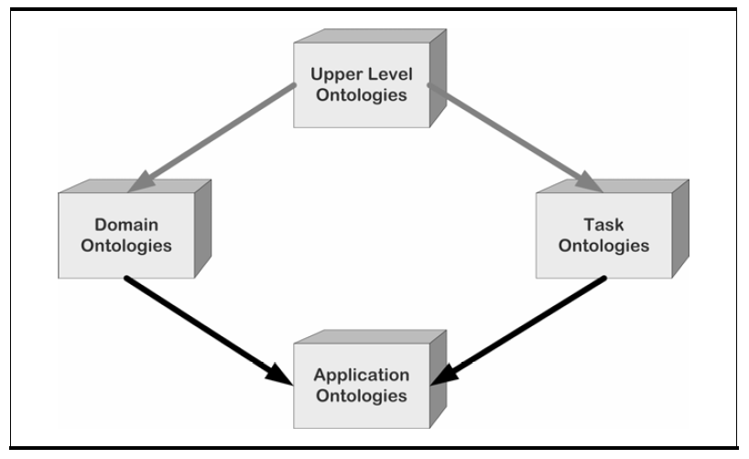
Classifying Ontologies According to Their Generality
Classifying Ontologies

Slide 30
Classifying Ontologies According to the Information Represented
Knowledge representation ontologies
Generic and common use ontologies
Upper ontologies describe general concepts
Domain ontologies
Task ontologies
Domain-task ontologies
Method ontologies
Application ontologies

Slide 31
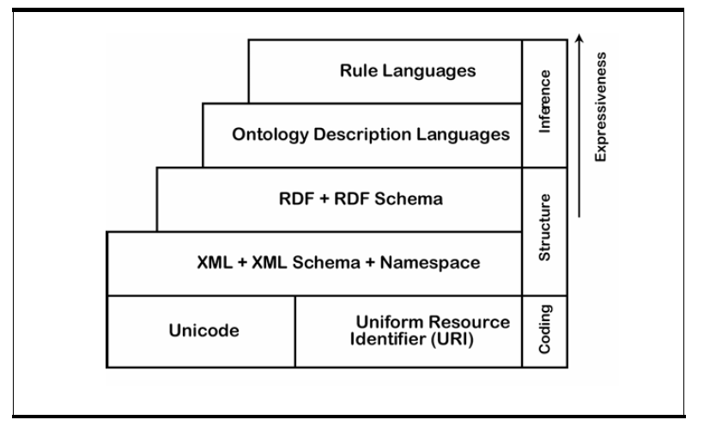
Web Ontology Description Languages

Slide 32
Web Ontology Description Languages
The Resource Description Framework (RDF) is a general-purpose language for representing information about resources in the Web.
The lack of expressiveness of RDF was partly eased with the introduction of the RDF Vocabulary Description Language 1.0: RDF Schema (RDF Schema or RDF- S), which offers primitives to model hierarchies of classes and properties.

Slide 33
Web Ontology Description Languages
Several ontology description languages, such as SHOE, Oil, DAML, DAML+Oil, and OWL, were later defined based on RDF/RDF-S.

Slide 34
Web Ontology Description Languages
Developed at the University of Maryland, the Simple HTML Ontology Extension (SHOE) was the first ontology description language created for the Semantic Web.
The Ontology Inference Layer (Oil) is the result of the On-To-Knowledge Project, sponsored by the European Community, which involved several European universities.

Slide 35
Web Ontology Description Languages
At about the same time Oil was developed, the Defense Advanced Research Projects Agency (DARPA) sponsored the DARPA Agent Markup Language (DAML) Program.
These two languages were amalgamated into a single language, DAML+Oil, in early 2001.

Slide 36
Web Ontology Description Languages
The Web Ontology Language (OWL) was the result of the Web Ontology Working Group (now closed).
OWL facilitates greater machine interpretability of Web content than that supported by XML and RDF/RDF Schema by providing additional vocabulary, based on description logic.
OWL has three increasingly expressive sublanguages: OWL Lite, OWL DL, and OWL Full.

